Slide 1
Patricio Montes
Sam Mandujano
Laura Beltran
Hugo Vazquez

Slide 3
“Foreigners are 30% more likely to be mugged”
“10% of those muggings are violent”
“Foreigners are 30% more likely to be mugged”
“10% of those muggings are violent”

Slide 4
“Foreigners are 30% more likely to be mugged”
“10% of those muggings are violent”
What if we could reduce that number
in even a .1%?

Slide 6
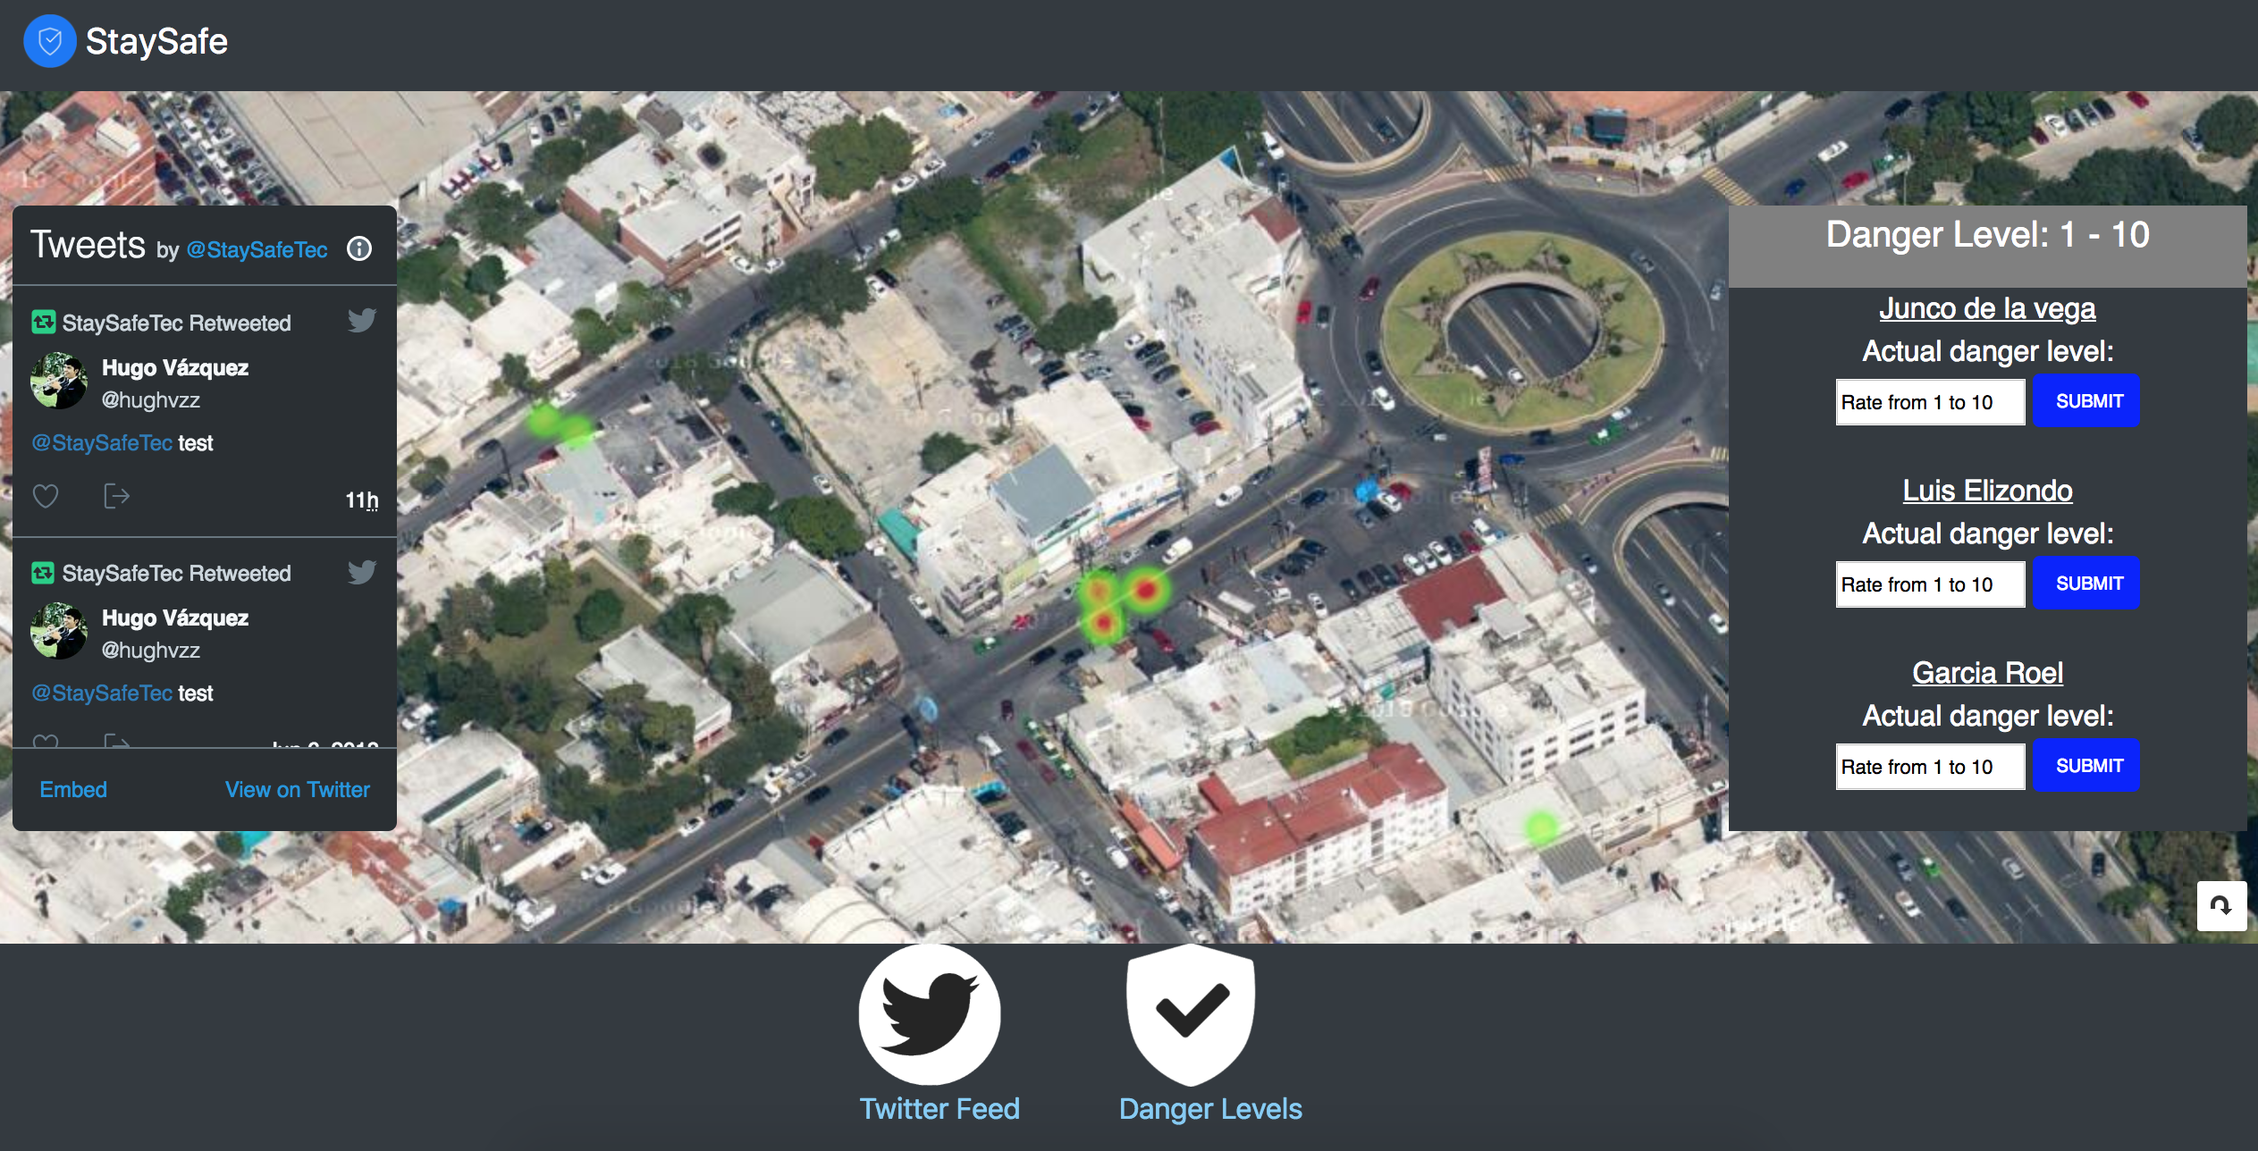
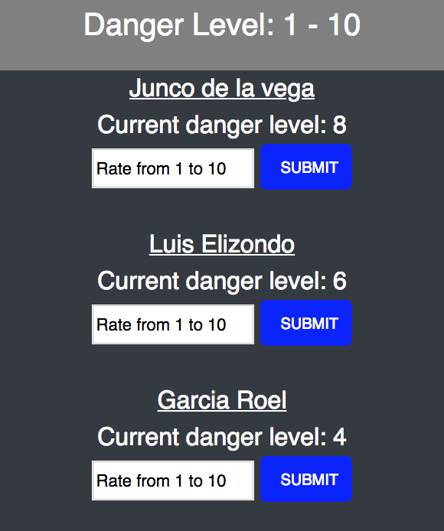
You can create
alerts

Slide 7
Check the
twitter reports

Slide 8
Check the
street danger
level

Slide 9
Allows people to check how safe is a street
before they walk in
Create awareness of zones that need
more policing

Slide 10
Steps taken to build the app
1.-Brainstorming Ideas
2.-API Research
3.-Create a Mockup
4.-Assign Individual Responsibilities
5.-Individual Work
6.-Cooperation, feedback, testing of individual responsibilities
7.-Merging & add interaction of all tasks of the Project
8.-Testing again of the final build.
9.-DEMO, ready….with issues

Slide 11
Responsibilities
Laura: HTML & CSS
Hugo: Google API
Samuel: Twitter API
Patricio: Firebase

Slide 12

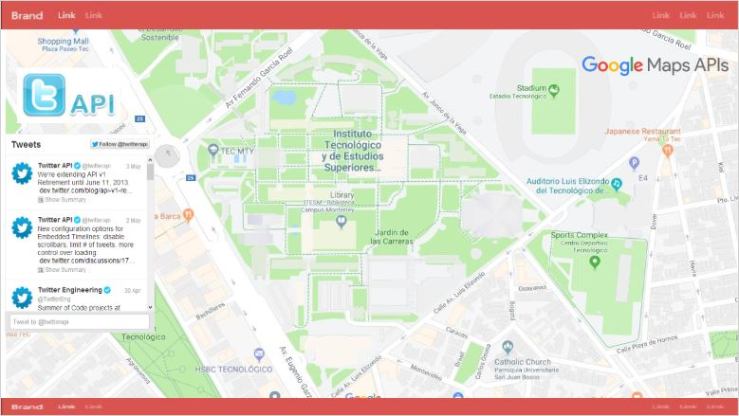
HTML & CSS
*Why Bootstrap? It offers the possibility of managing several designs that were adapted to the mockup of the page.
*How is it combine with the final page? We use some components like navbars and cards, and we adapt in our page.
*The bootstrap allows to have the same style in all the page, but at the same time, was a little complicated overwritten own styles.
*Individual Challenges: positioning, sizes and align, property.

Slide 13

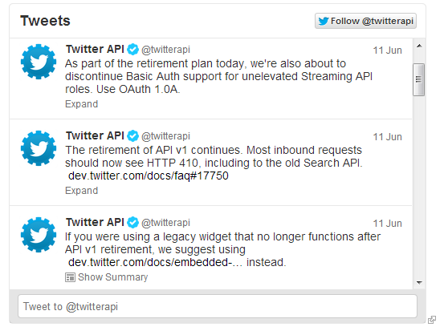
*Why Twitter? Is one of the most popular social media & simple user interface.
*How is it implemented? The users are able to warn & report criminal activity using tweets. They are also Informed of the current crime situation by the @StaySafeTec account.
*The API allows to update the tweet feed without the need of reloading the whole app.
*Individual Challenges: Documentation & for additional features, experience with Node JS is required.

Slide 14

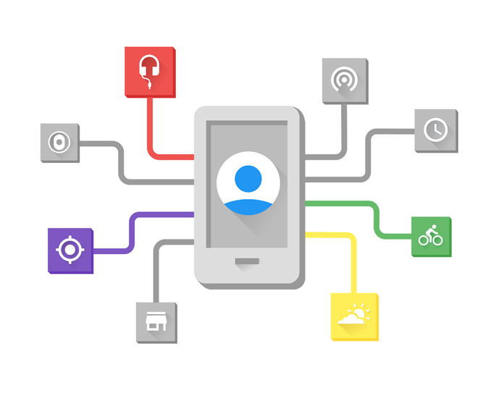
Google APIs was used as the primary tool in this project.
This API gives us a satellite view of the city allowing us to pinpoint the exact place a crime is committed.
Individual challenges:
Initial scope, planning, documentation, testing.

Slide 15
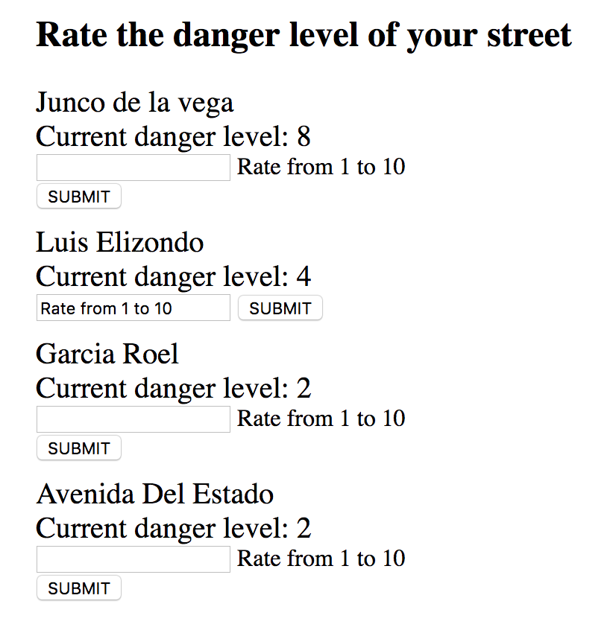
Firebase
With Firebase we can allow users to rate their streets. helping others receive a weighted average of all the ratings.
*Individual Challenges: Learning about firebase, implementing the javascript logic.

Slide 16
Group Challenges
We had to change the original idea
Tons...Tons… of API Documentation
Debugging
Merging every individual task into one functional application
Team Agreement
A single problematic line

Slide 17
DEMO

Slide 18
Future Improvements
Solve the problematic line
Allow comments on each hotspot
Add more streets to rate
Merge with Google Maps to influence the routes

